Slide 1

TASK 2
DATA INSIGHTS
Submitted by
Somya Bhushan
KPMG Virtual Internship
Case Study

Slide 2
The Analytics Team
Sprocket
Central Pty Ltd
Data Analytics Approach
[Division Name] - [Engagement Manager], [Senior Consultant], [Junior Consultant]

Slide 3
Agenda
Introduction
Data Exploration
Model Development
Interpretation

Slide 4
Introduction
CUSTOMER ANALYSIS
The following profiles will recommend which new customers should be targeted to drive the most value for the organization:
Geographical distribution of new customers
Age and Gender of customers
Number of bikes purchased by the customers in the past 3 years
Customers’ Profession Industry
Customers’ Wealth Segment

Slide 5
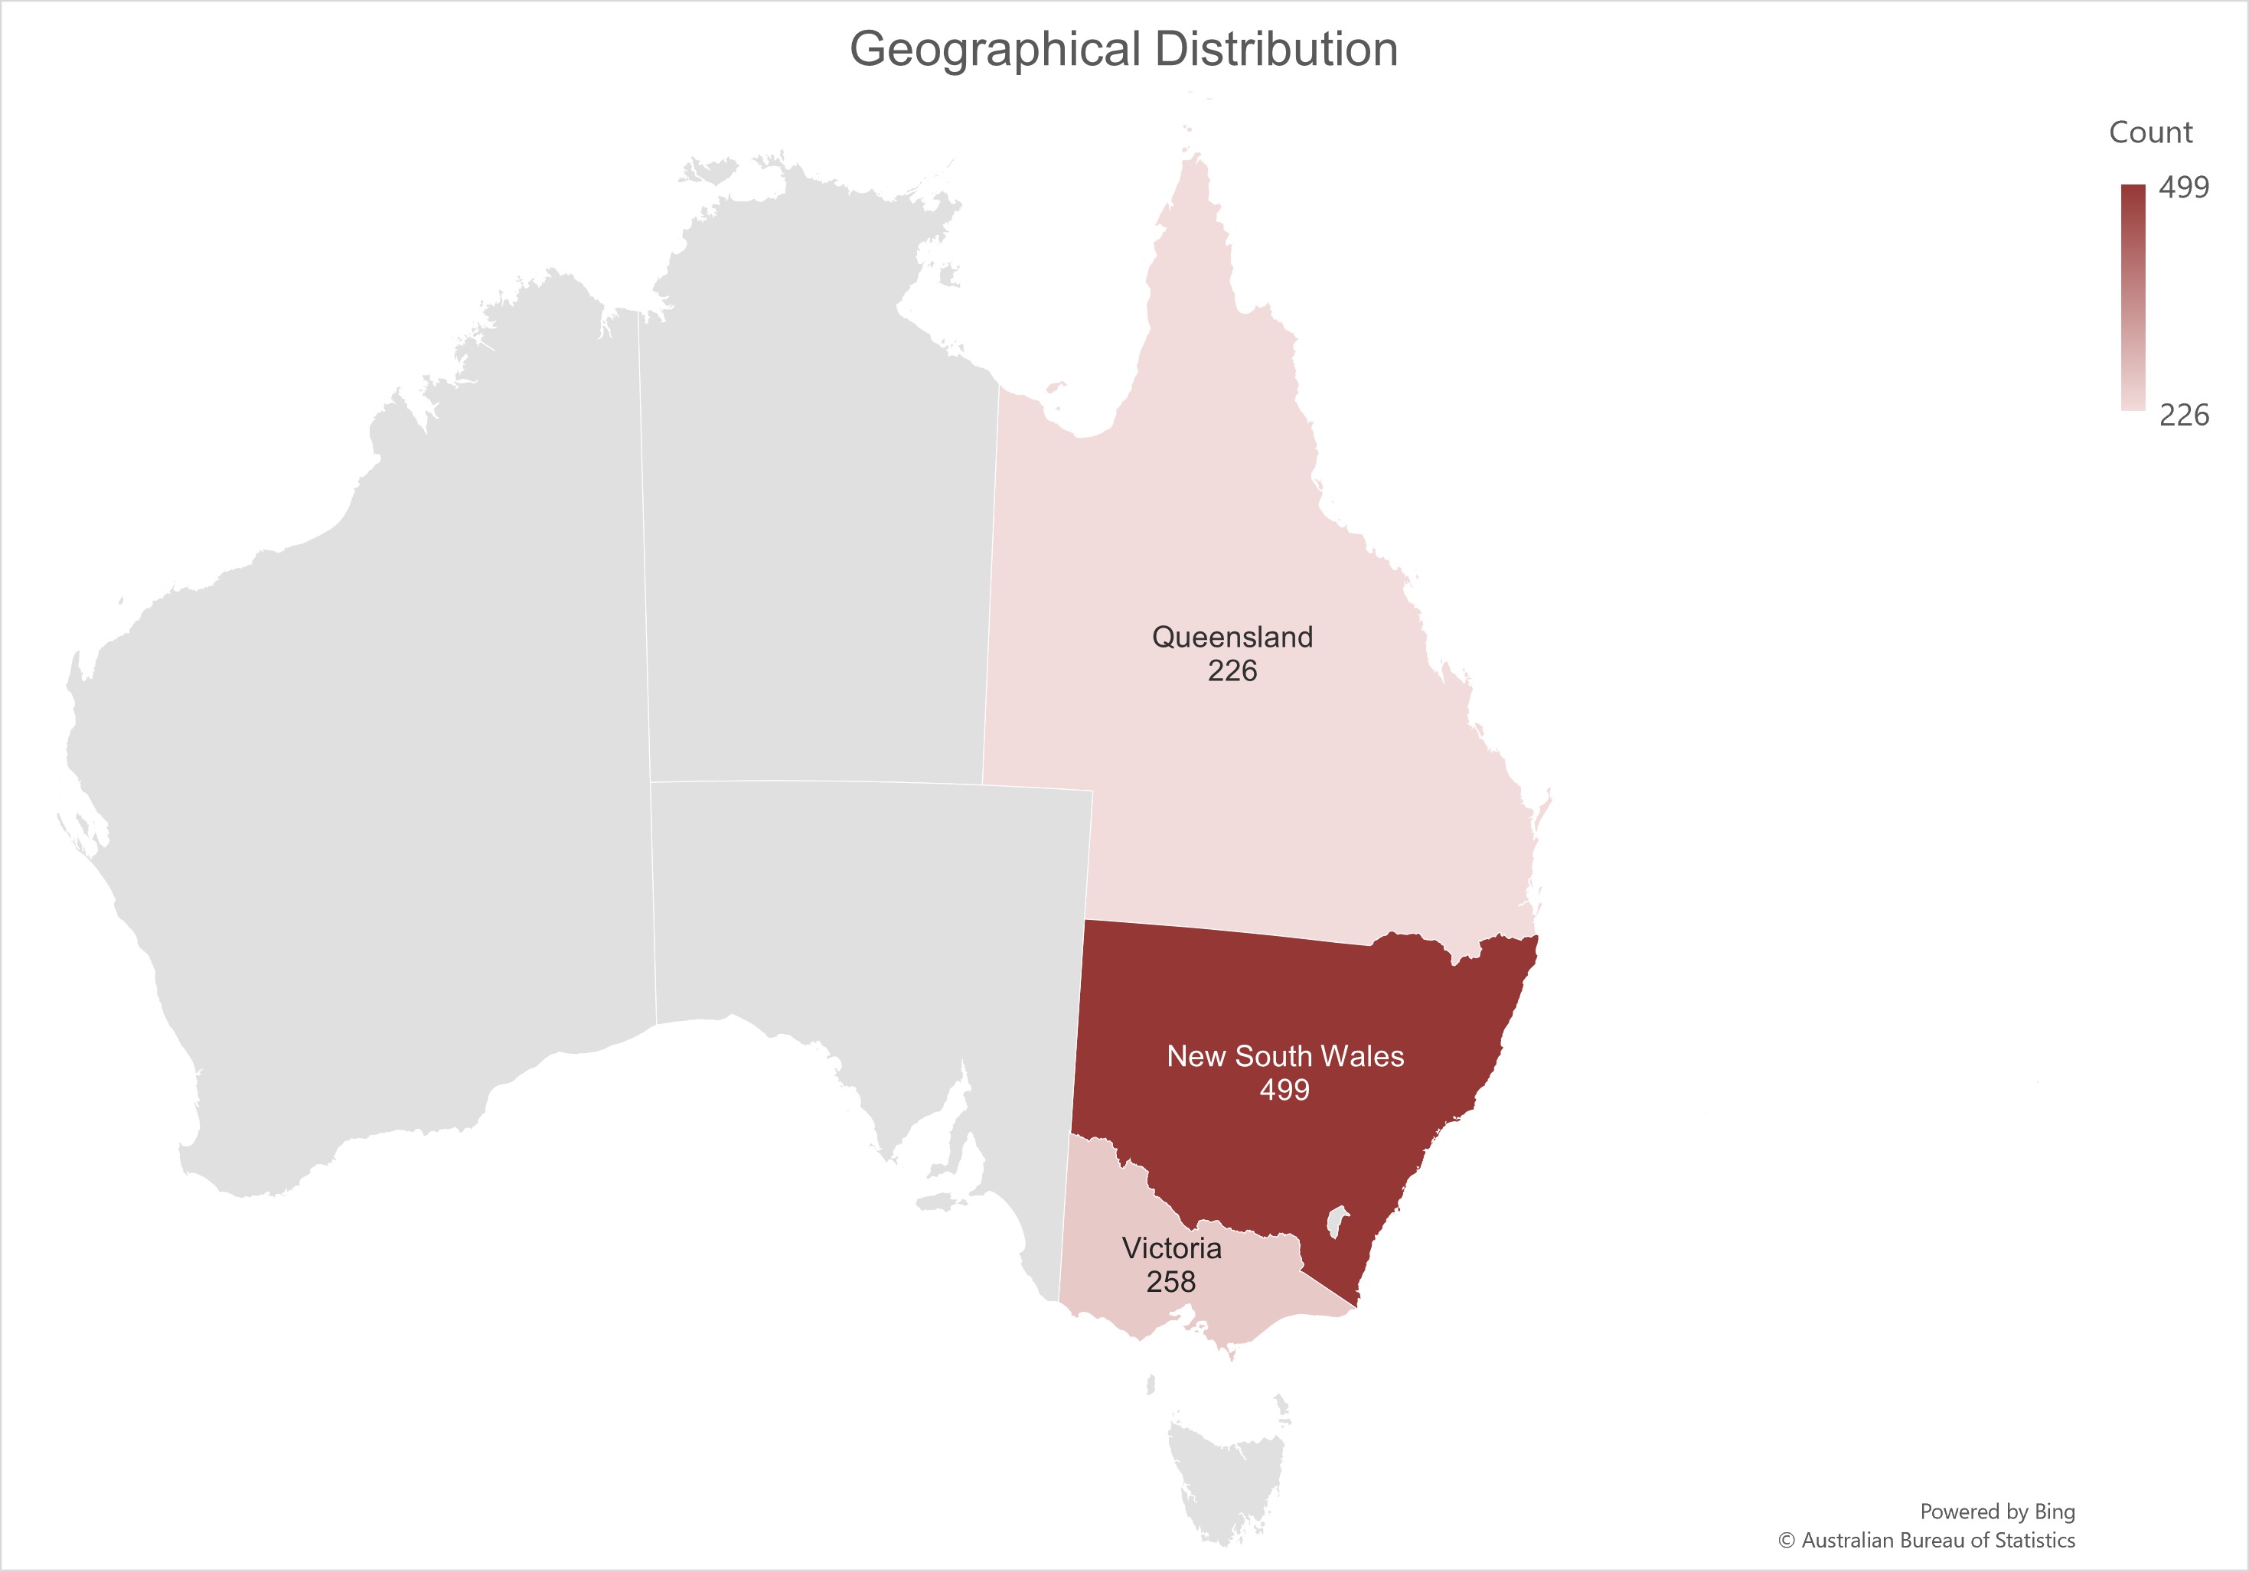
Data Exploration
Geographical Distribution of New Customers
Almost half of the new customers (approx. 50%) reside mainly from New South Wales state and hence, strategies should be made keeping this in mind.

Slide 6
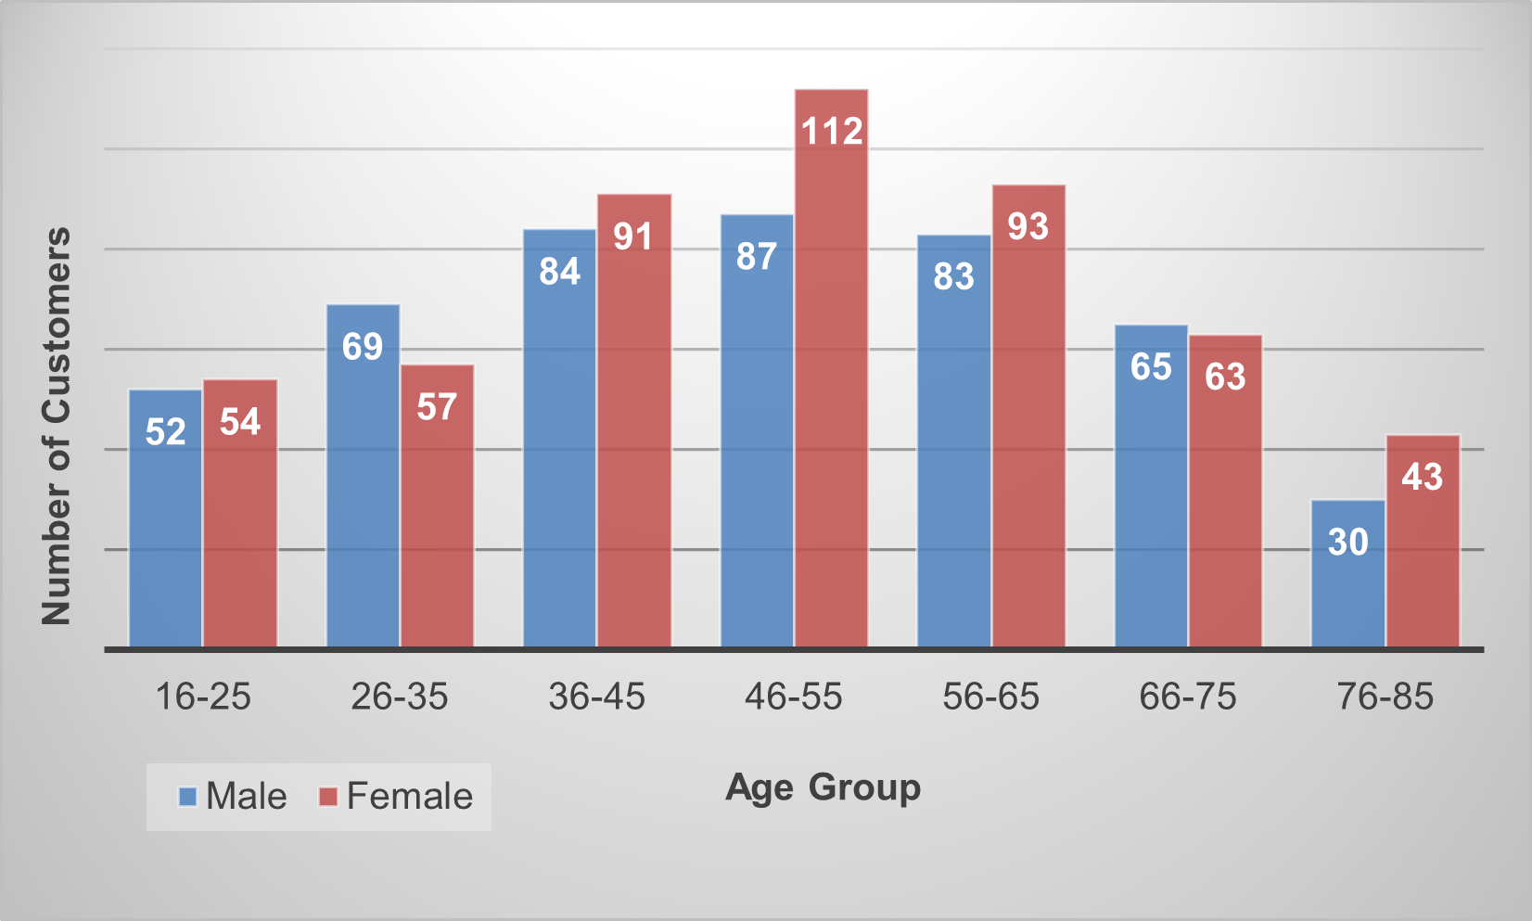
Data Exploration
Age and Gender Diversification of New Customers
Most of our new customers fall in the age group of 46-55 years old, followed by 56-65 and 36-45 years old. The elderly customers(76-85) have relatively low engagement.
Also, number of new customers have relatively high female participation than males.
The middle-aged group and female customers should be given priority to boost business.

Slide 7
Model Development
Null Hypothesis: There is no difference in the mean proportion of purchase of bike in the past 3 years between males and females.
From the table, we are accepting null hypothesis which suggest that even though number of female customers is high, there is no difference in the mean proportion between males and females regarding purchase of bikes in the past 3 years.

Slide 8
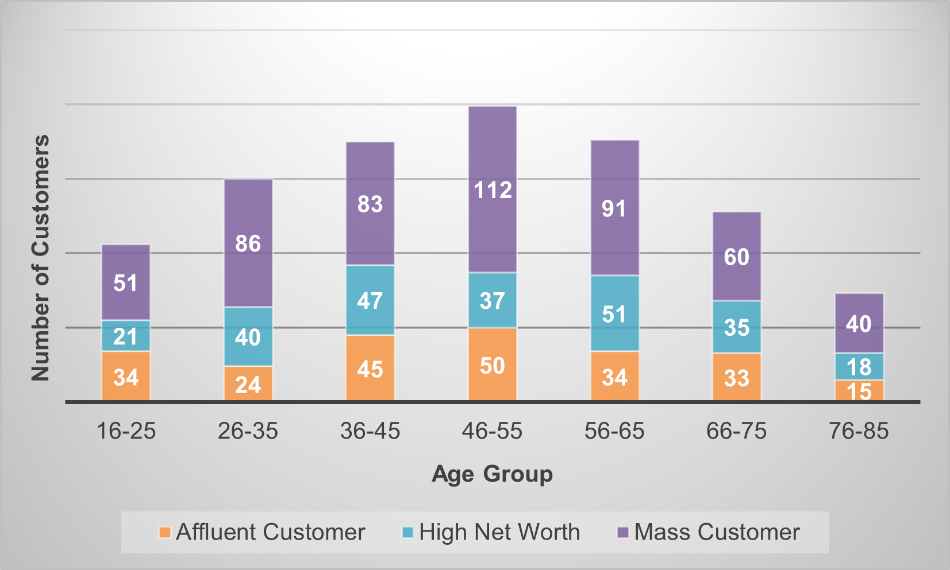
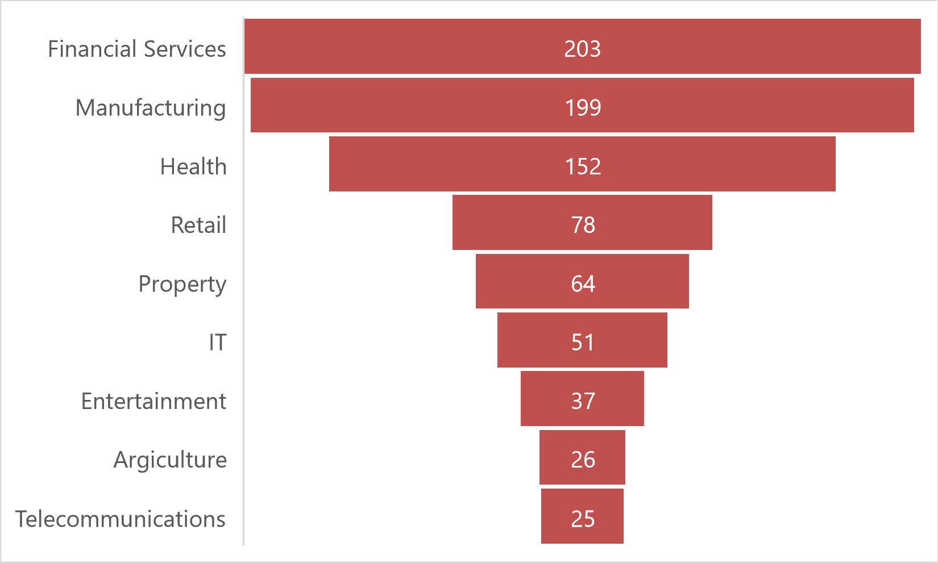
Interpretation
Customers’ Profession Industry and Wealth Segment
New customers mostly work in Finance and Manufacturing industries.
And most of them come under mass category of social class in every age group.
In a nutshell, customers residing in New South Wales of age group 46-55 working either in finance or manufacturing industry belonging to mass population should be given utmost attention to boost business and to create a strong potential customer base.

Slide 9
Thank You!

